Slide 1
Project Description:
Report: IMDB Movie Analysis
1. Project Description
Overview: This project investigates factors that influence the success of movies on IMDB, with success defined by high IMDB ratings. The goal is to provide insights into the characteristics that make a movie successful, such as genre, duration, language, budget, and director.
Objective: The analysis aims to support movie producers, directors, and investors by identifying trends and patterns in movie success. These insights can guide better decision-making for future projects.
Approach: We explored the dataset by conducting several key analyses, including genre distribution, duration analysis, language analysis, director performance, and budget impact. Each of these aspects was compared to movie ratings and gross earnings to draw meaningful conclusions.

Slide 2
2. Approach
Data Cleaning: First, the dataset was cleaned by removing missing values and handling multiple genres for each movie. Duplicates were eliminated, and relevant columns like genres, duration, language, director_name, and budget were used for analysis.
Exploratory Data Analysis (EDA): The data was explored through visualizations and statistical computations to understand relationships between different variables (e.g., genre, budget, director, etc.) and their impact on movie ratings.
Techniques: We used Python for data wrangling, statistical analysis, and data visualization. Key libraries like Pandas, Matplotlib, and Seaborn were employed.

Slide 3
3. Tech-Stack Used
Python: Version 3.8, used for data cleaning, wrangling, and statistical analysis.
Pandas: Used for data manipulation and creating structured tables.
Matplotlib: Used for generating plots to visualize trends and relationships.
Seaborn: Used for more advanced data visualizations, including scatter plots and trend lines.
Jupyter Notebook: Used as the IDE for coding, visualization, and documenting findings.
Excel (Optional): Microsoft Excel 2022 was also mentioned as a possible tool for handling similar tasks like descriptive statistics and scatter plot generation.

Slide 4
4. Insights
Movie Genre Analysis:
Action and Adventure movies are the most common genres, and they also tend to have higher IMDB ratings compared to other genres.
Genres like Documentary have niche audiences but often feature very high ratings.
Movie Duration Analysis:
The analysis showed that longer movies tend to have slightly higher ratings, though the correlation was moderate. The sweet spot for movie duration seems to be around 150 minutes.
Language Analysis:
English dominates the movie industry, with the highest number of movies and strong ratings. Other languages with high ratings include Spanish and French, suggesting quality over quantity for non-English films.
Director Analysis:
Directors like Christopher Nolan and James Cameron have consistently higher ratings than the average. Directors who tend to focus on a specific genre (such as Action or Thriller) often perform better on IMDB.
Budget Analysis:
There’s a positive correlation between higher budgets and gross earnings, but the relationship with IMDB ratings is weaker. High-budget movies generally perform well financially but do not always guarantee higher ratings.

Slide 5
5. Result
Key Achievements:
The analysis successfully identified critical factors influencing a movie’s success on IMDB, such as genre, director choice, and budget allocation.
The genre and director analysis provided actionable insights for stakeholders in the movie industry, enabling them to focus on successful patterns.
Understanding Improved: The project highlighted that while bigger budgets often lead to higher gross earnings, they don’t always guarantee higher ratings. On the other hand, the director’s role and the genre of a movie are strong predictors of IMDB success.

Slide 6
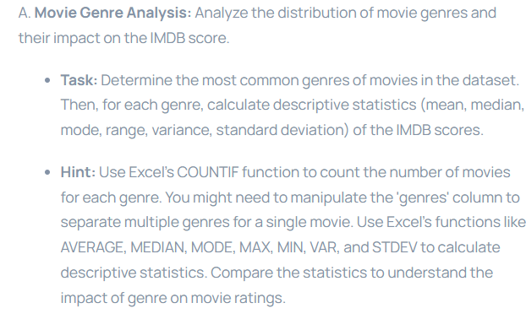

Slide 7
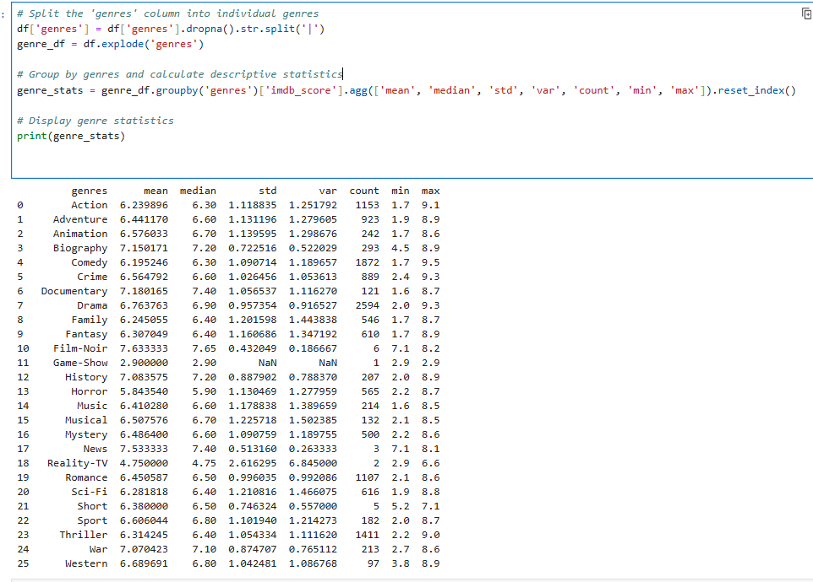

Slide 8
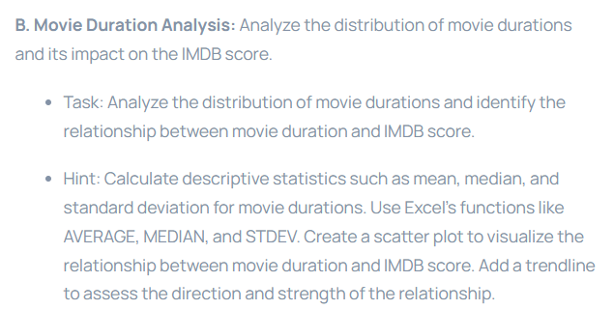
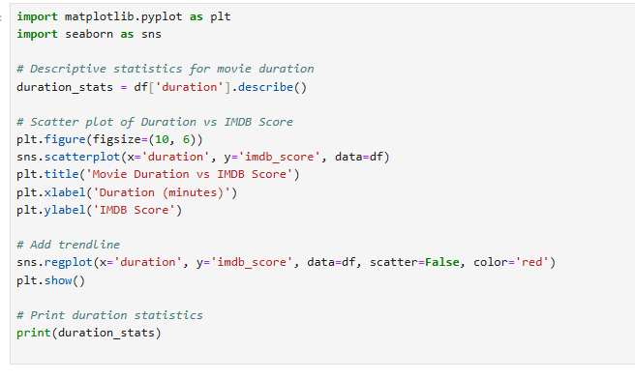

Slide 9
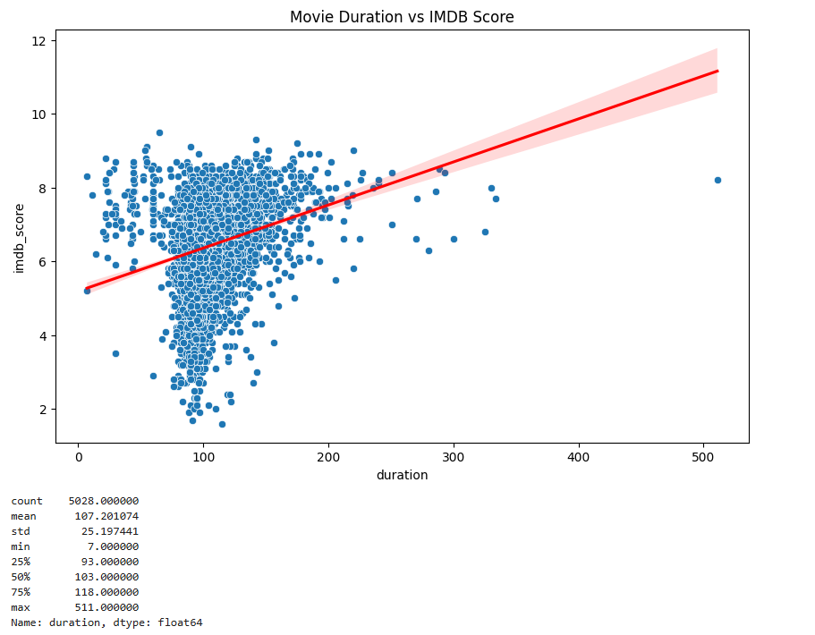

Slide 10
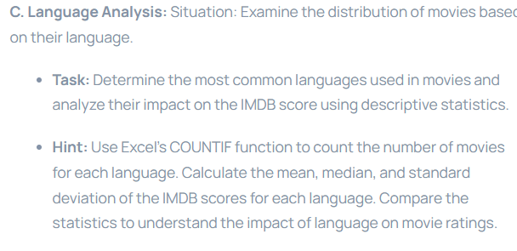
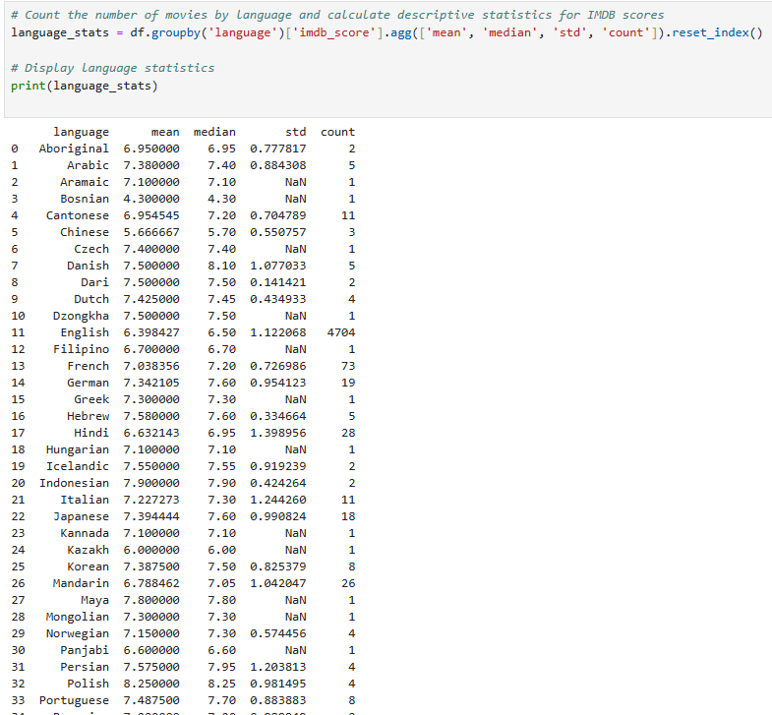

Slide 11
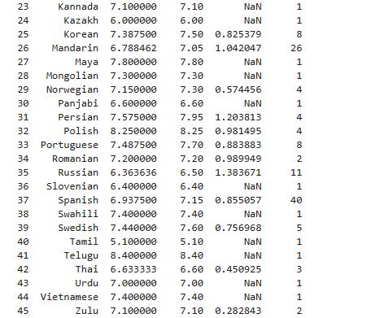

Slide 12
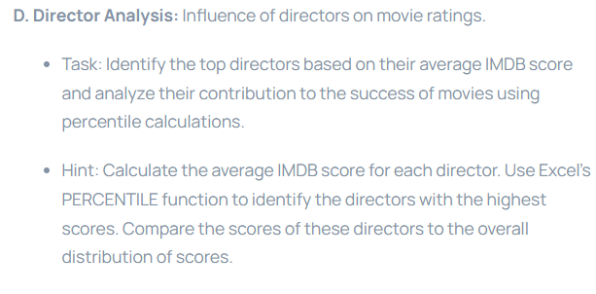
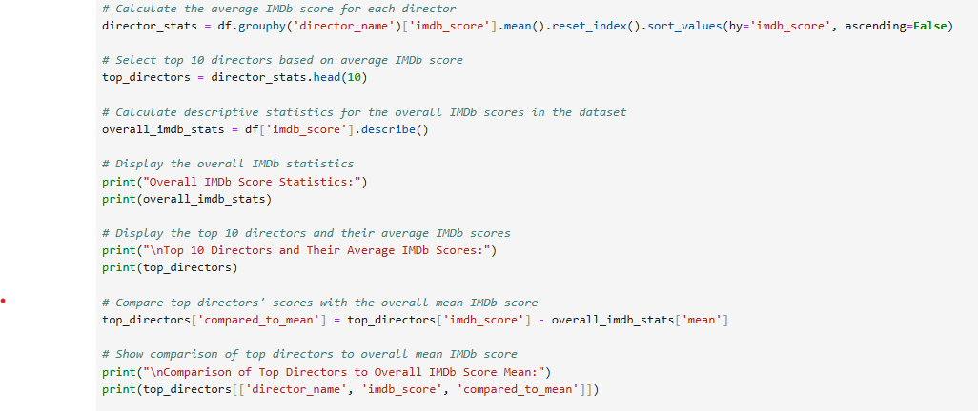

Slide 13
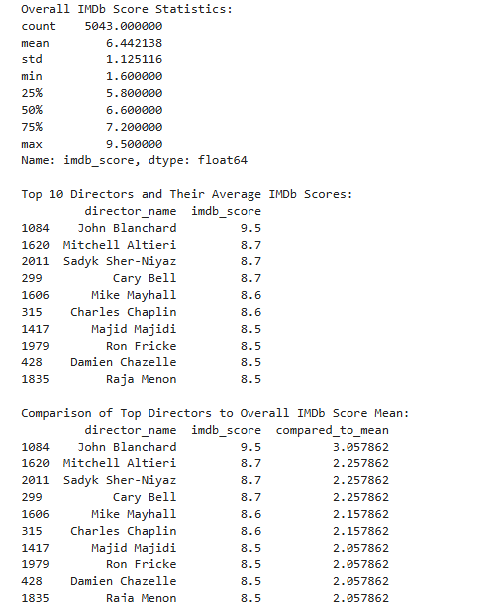

Slide 14
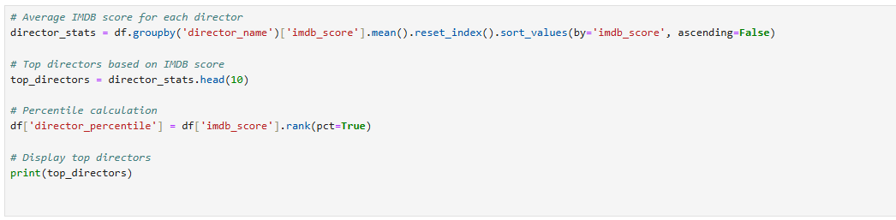
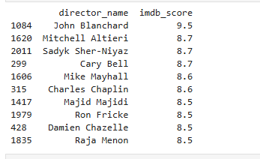

Slide 15
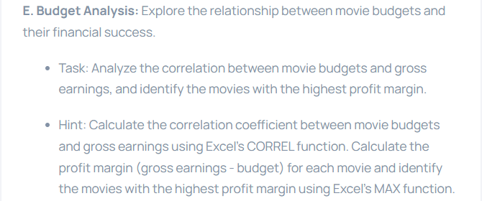


Slide 16
Thank You !

